Slide 1
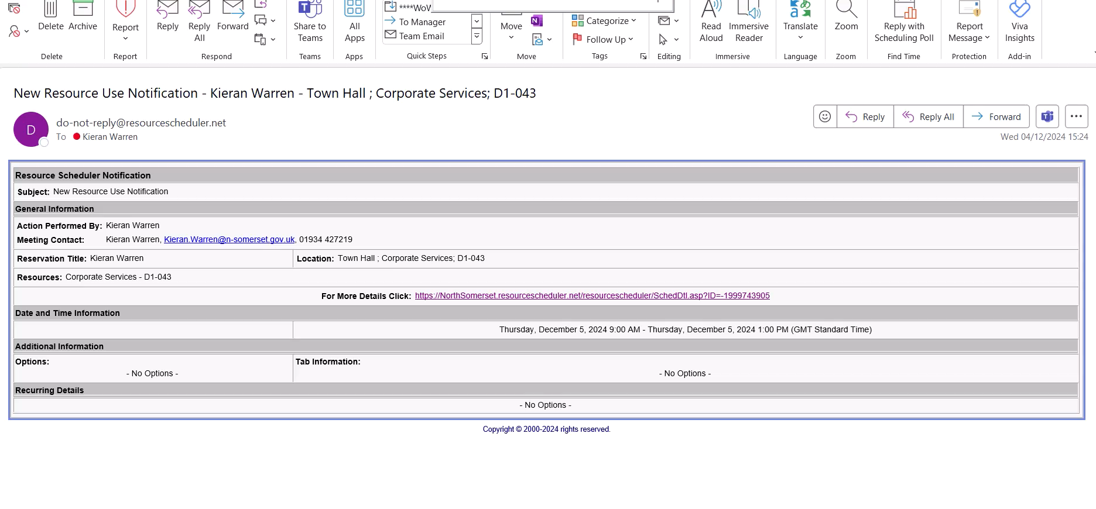
Check in via email
Notes:
You must check-in to your booking within the hour or it will be released back to the system
There are 2 ways to do this.
Click on the link in your reservation email to open up the booking in the web portal
Click on the check in box
Click save at the top of the screen

Slide 2
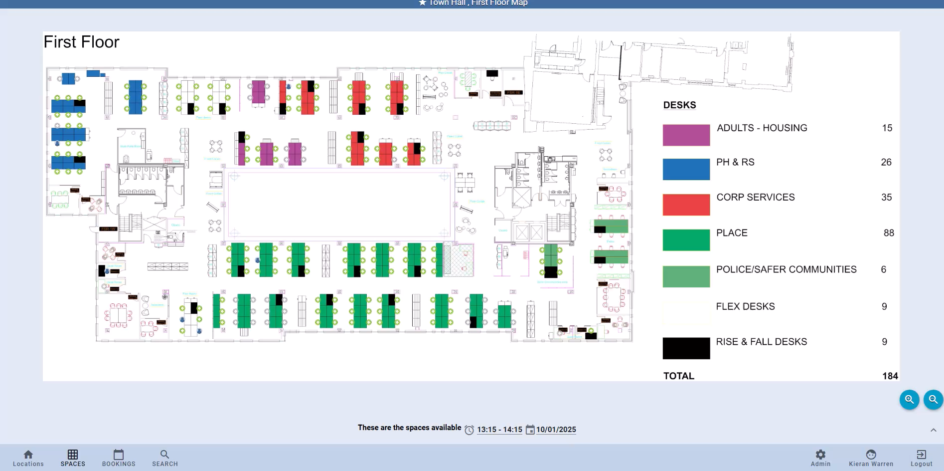
Check in and out via Map View
Notes:
Click on Bookings (bottom left)
Click on Your upcoming bookings
Select the booking you want to check in to
Click check in (right hand side)
If you finish your booking early, follow the same process and click Check out

Slide 3
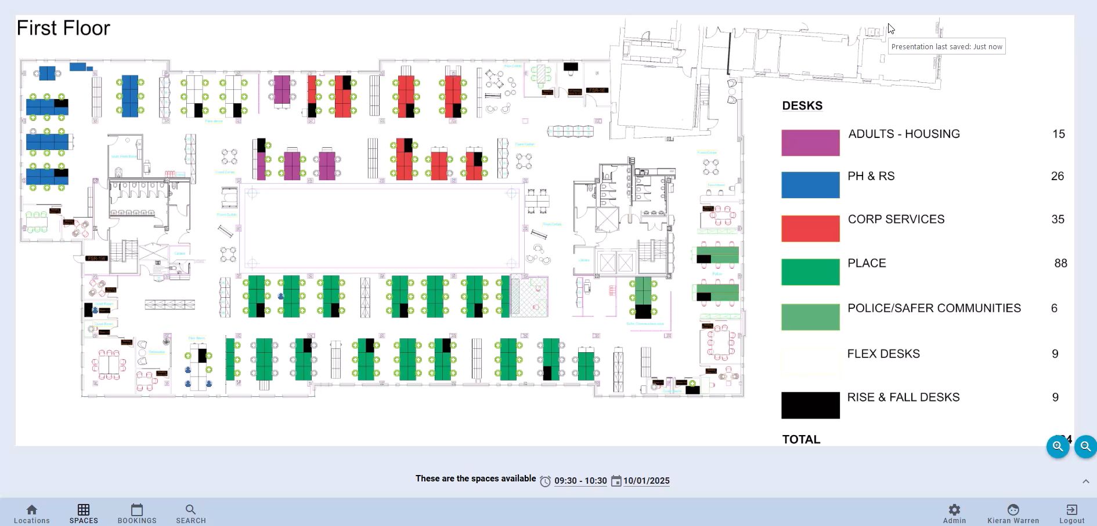
Cancelling a booking within 7 days
Notes:
If you no longer need your booking, please remember to cancel it so that it is available for others to book.
If the booking you want to cancel is in the next 7 days, click on the Bookings icon, select the booking you want to cancel and click delete and then close.

Slide 4
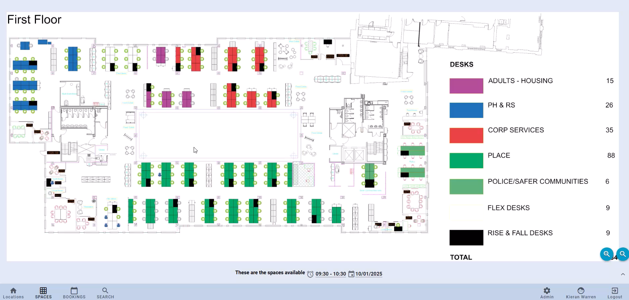
Cancelling a booking more than 7 days ahead
Notes:
If the booking you want to cancel does not appear here as it’s further into the future, enter the date and time of your booking, click on the desk to bring it up. Then press Delete.

Slide 5
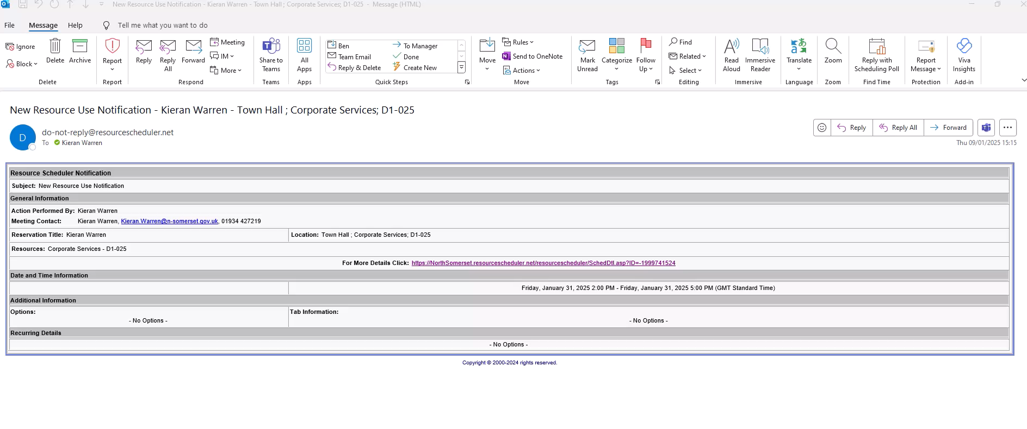
Cancelling a booking via email
You can also cancel any booking from the web link in your booking confirmation email.
Notes:
You can also cancel any booking by clicking on the web link in your confirmation email
The booking will open up in the web portal
Click on the blue More button at the top right of your screen
Select Delete
Click ok

Slide 6
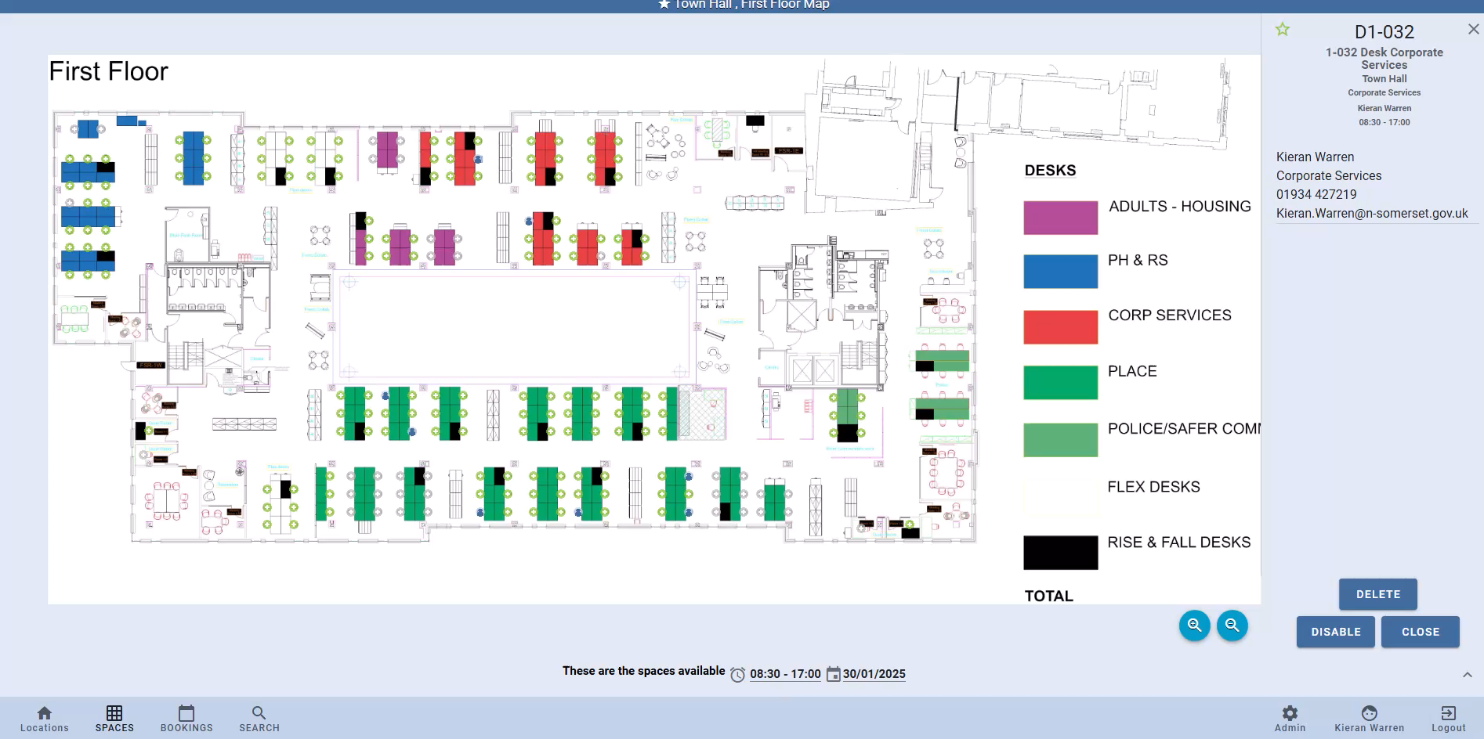
Book multiple desks
Notes:
Sometimes you may want to book more than one desk at a time, for example if you plan to work with a colleague on a piece of work or carry out training with a new team member.
Unfortunately, it’s not possible to select multiple desks and make a block booking so you will need to book each desk individually as we have demonstrated earlier.
Select the date and time for your reservation by clicking on the clock and calendar icons which will bring up the spaces available.
Click on Book and start typing the name of the colleague you are booking for and it will bring up a drop-down list. Select the correct colleague and click Book.
The map view will then show that the desk is booked for that colleague. The booking will appear in both your bookings list and the delegate’s booking list in Resource Scheduler home page. You will both receive a booking notification email which will have your colleague’s name and contact number on it.
Both parties will also be able to check-in to the desk.

Slide 7
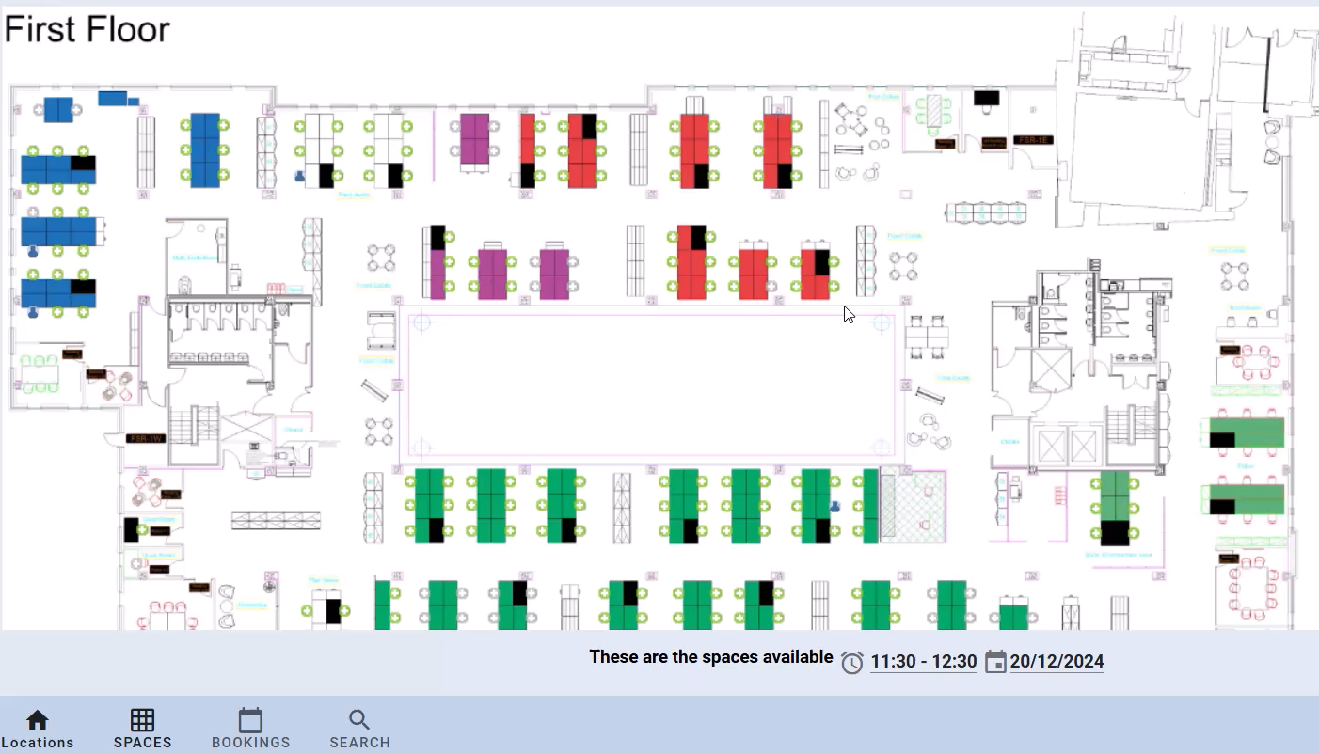
How to search for a colleague
Notes:
It’s possible to see where your colleagues are sitting which is helpful if you want to know if they are in the Town Hall or if you want to book a desk by them
Click on the Search icon at the bottom left of your screen which will bring up What can we help you find? Click on this.
Then click on Person
Then type in the name of the colleague you are looking for in the search text box
Click on their name and this will bring up a box with all their current bookings in it.
If you want to see exactly where they are sitting, click on the icon next to the date and it will take you to the floor plan.
The desk where they are sat will be shown with a blue icon.

Slide 8
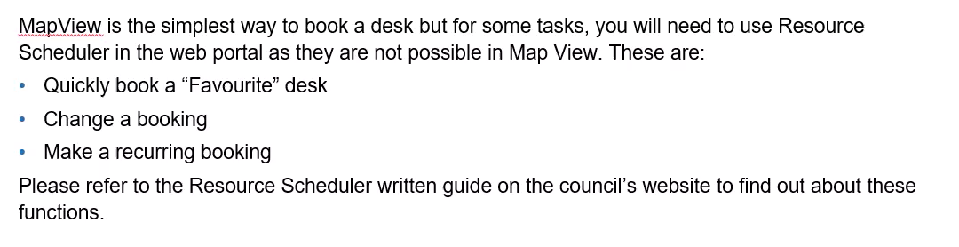
Functions not supported in MapView

Slide 9
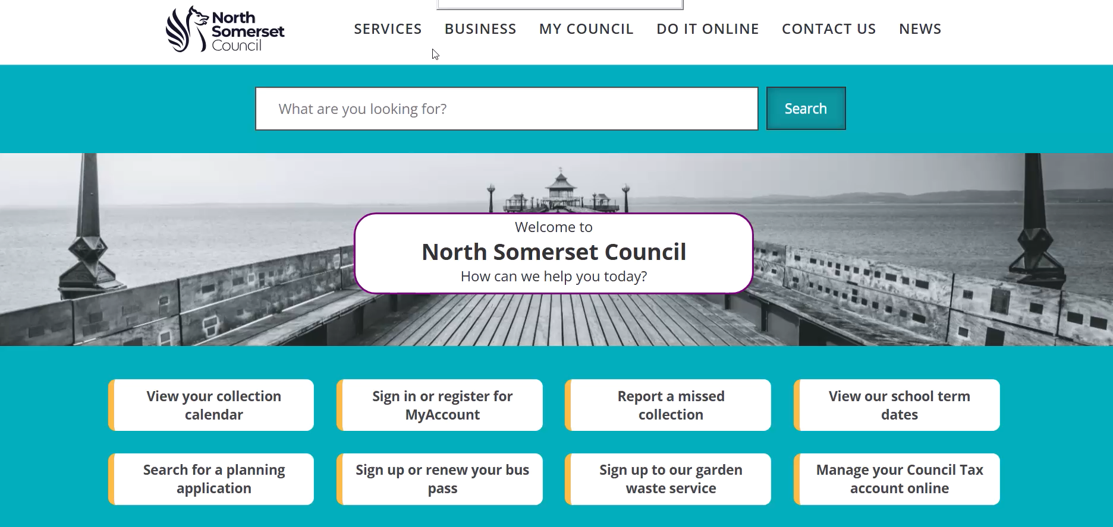
More support

Slide 10
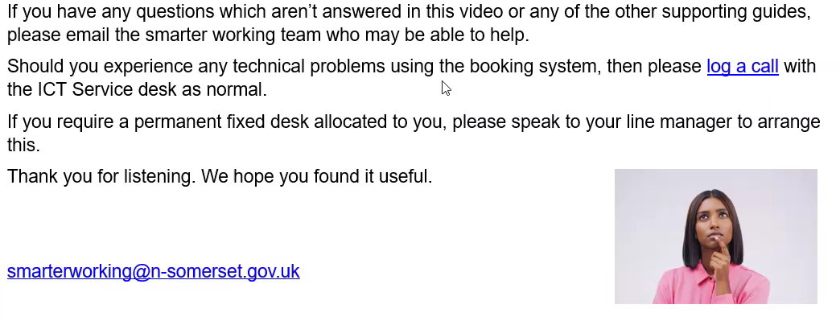
More support

